Slide 1

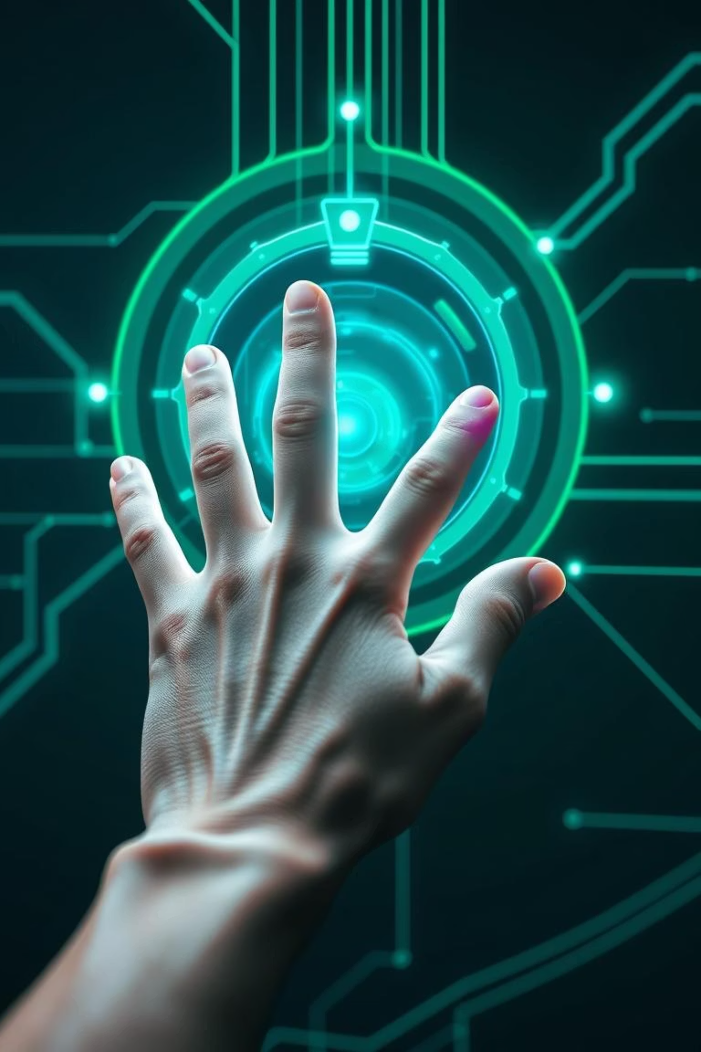
MotionMind – Smart Gesture Recognition for Control Systems
Department of Computer Science & IT
Group Members:
• M. Furqan Masood (SAP: 70132359) • Usama Arshad (SAP: 70132355)
Supervisor: Duaa-e-Nadeem
Session: Spring 2022 – 2026

Slide 2

Executive Summary: MotionMind
AI-Powered Platform
Interprets real-time hand gestures using standard webcams.
Problem Solved
Addresses lack of accessibility, hygiene, and inclusivity in traditional input methods.
Touch-Free Control
Enables control for whiteboards, presentations, and games.
Broad Scope
Useful in education, professional presentations, and cognitive
gaming.

Slide 3

Introduction: Evolving Interaction
Background & Motivation
Key Objectives
Human-computer interaction is evolving, but touch interfaces have hygiene and inclusivity limits. We need affordable, multi-purpose gesture systems for shared environments.
AI-based hand gesture control via webcam.
Whiteboard, gaming, and presentation modules.
Inclusive and scalable solution.

Slide 4

Problem Statement & Existing System Issues
Problem Statement
Touch-based systems are non-hygienic, costly,
and non-inclusive.
Existing Limitations
Expensive hardware (Kinect, Leap Motion).
Limited to single-use applications.
Complex setup, lack of accessibility.
Minimal disability support.

Slide 5
Competitive Analysis
Feature / Product
SpatialTouch
KinScreen
MotionMind
Gesture Control
Basic
Limited
✅ Advanced
Multi-Functionality
❌
❌
✅ Yes
Cost-Effective
❌
❌
✅ Yes
Educational Utility
❌
❌
✅ Yes
Gaming Integration
❌
❌
✅ Yes
MotionMind's strength lies in its multi-featured, AI-powered, webcam-based approach, filling gaps in affordability, accessibility, and multi-purpose use.

Slide 6



Gap Analysis: Opportunities for MotionMind
Identified Gaps
Key Opportunities
No integration of learning, gaming,
and presentations.
Affordable solution with webcam.
Inclusive design.
Costly hardware requirements.
Versatile for education and professionals.
Low adaptability for disabled users.

Slide 7
Functional Requirements Overview
FR_01 – Create Account
FR_02 – Login Account
FR_03 – Logout Account
FR_04 – View Profile
FR_05 – Edit Profile
FR_06 – Delete Account
FR_07 – Gesture-Controlled Whiteboard
FR_08 – Gesture-Based Games
FR_09 – Presentation Navigation via Gestures
FR_10 – View Performance Report
FR_12 – Help/FAQ Access
FR_13 – Settings
FR_14 – Gesture Calibration
FR_15 – Admin Dashboard

Slide 8
Functional Requirements
ID
Name
Input
Output
Basic Workflow
FR_01
Create Account
Name, Email, Password
Account- Created
Save user details to DB after validation
FR_07
Gesture-Controlled Whiteboard
Hand Gestures
Drawing/Erase
Interpret gestures and apply on canvas
FR_09
Presentation Navigation
Swipe Gestures
Slides Change
Detect gestures to navigate slide accordingly
Additional features include Games, Profile, Reports, Admin Dashboard, and Calibration.

Slide 9

System Requirements
Hardware
Software & Environment
Webcam (≥720p)
Python, Flask, OpenCV, MediaPipe
4GB RAM
HTML/CSS/JS, MySQL, XAMPP
Intel i3 or better
Web browser (Chrome, Firefox)
OS: Windows/macOS/Linux
Tools: VS Code, Bootstrap

Slide 10
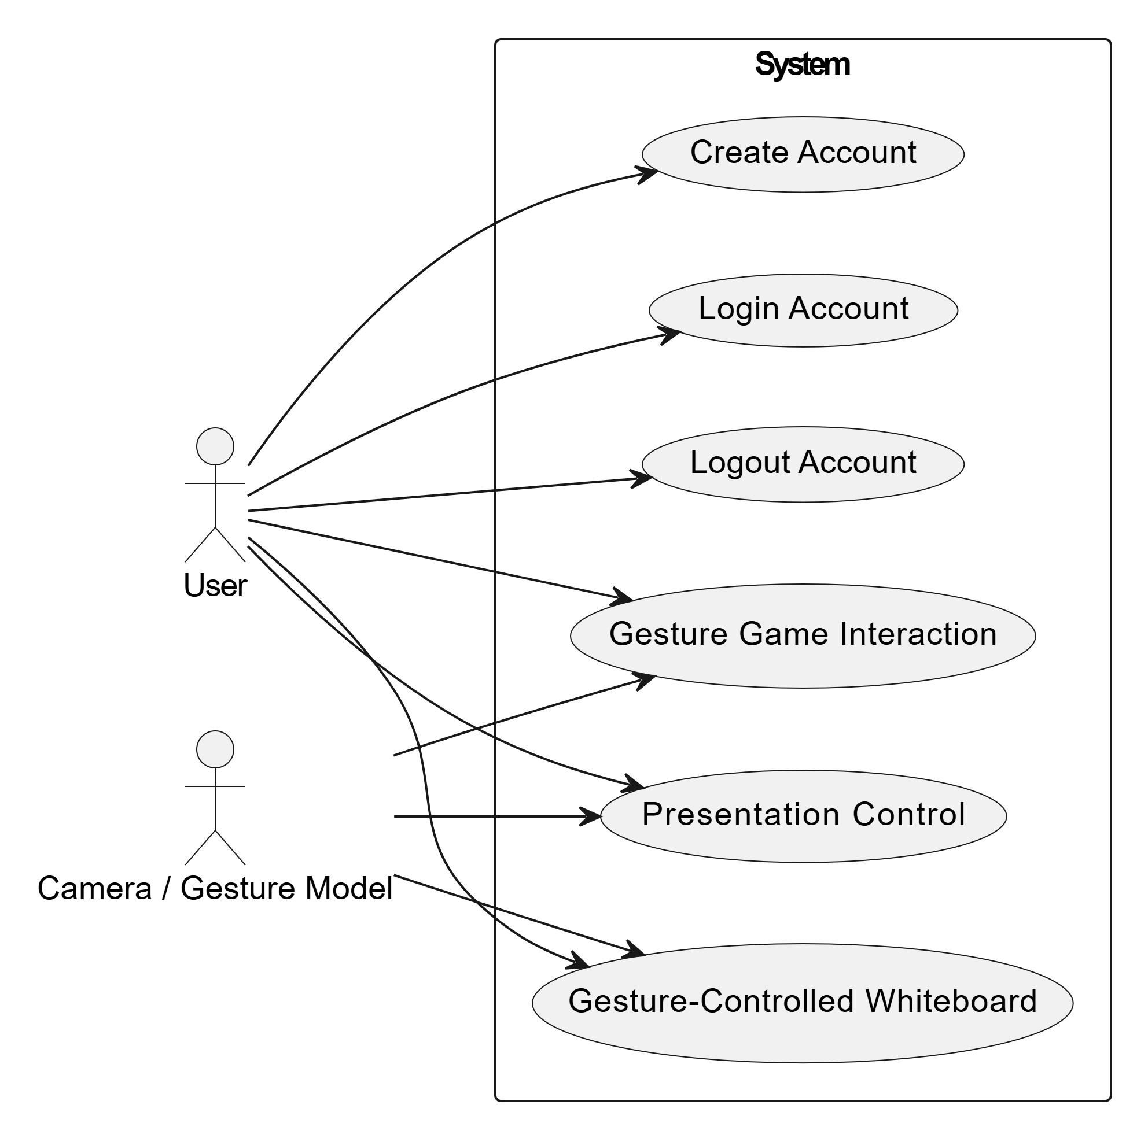
Use Case Diagrams
Aggregated Use Cases include Account Management, Gesture-Controlled Modules, and Admin Dashboard.
Figure 1 Aggregated Use Case

Slide 11
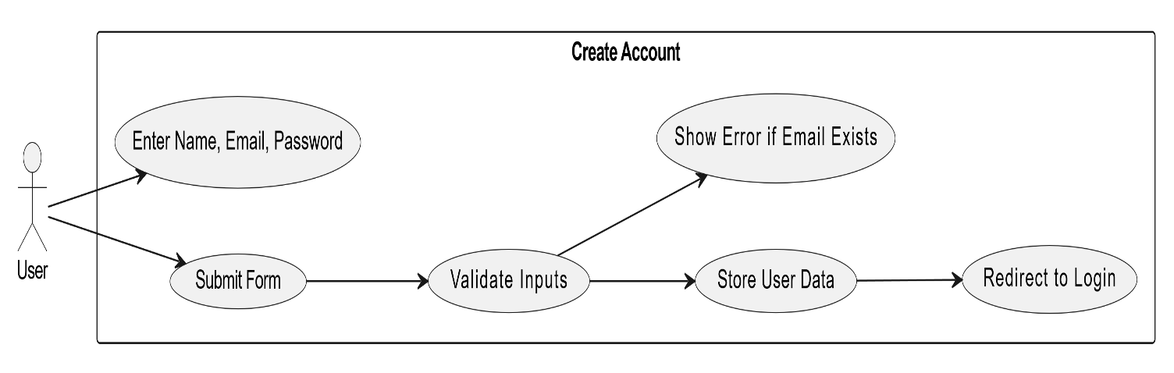
Create Account:
Figure 2 Use Case – Create Account

Slide 12
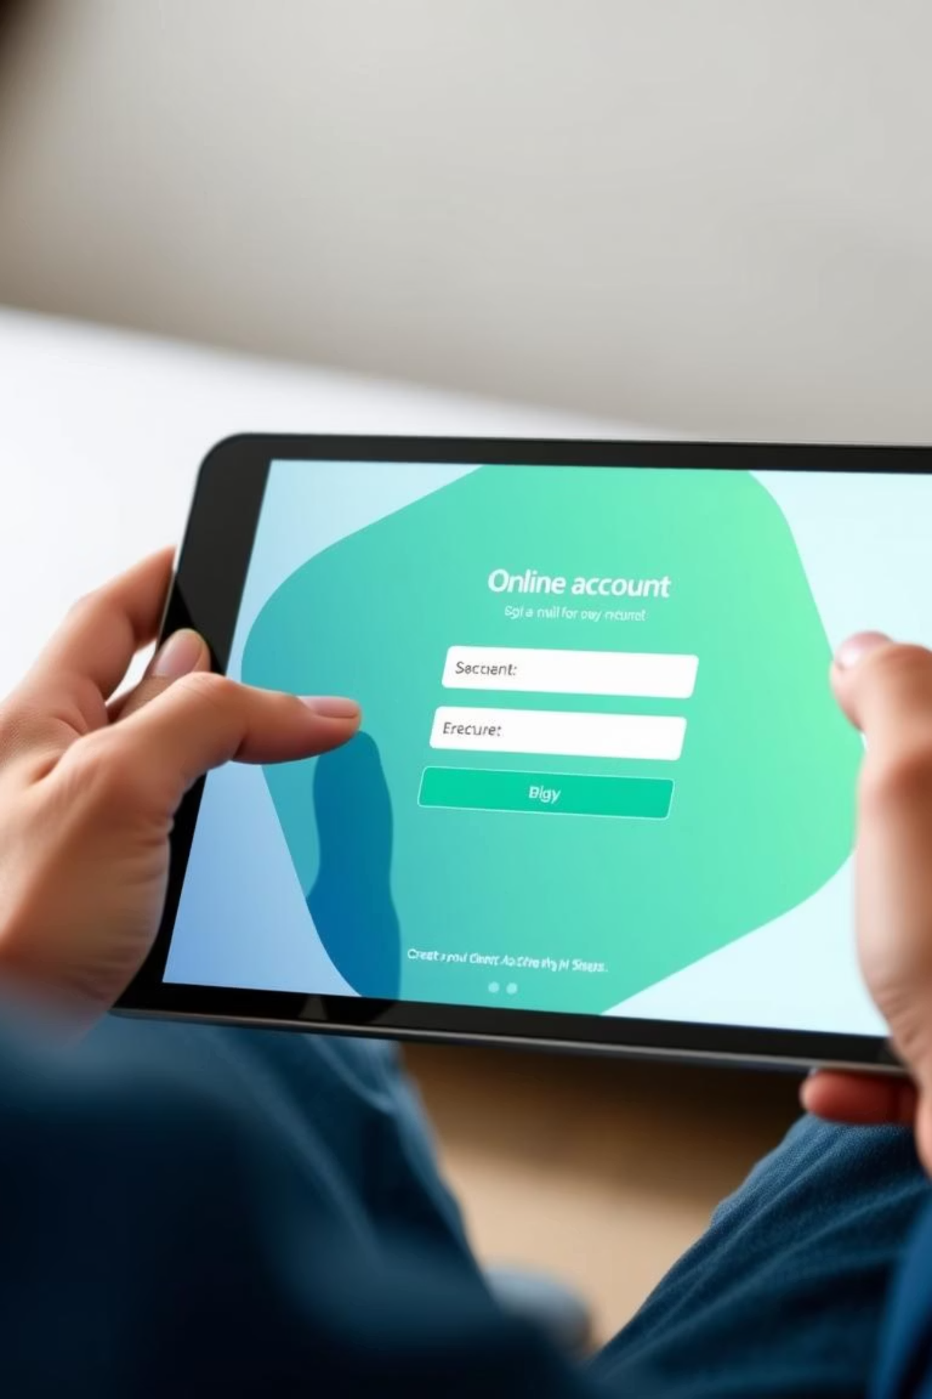
Use Case Descriptions
UC – Create Account
Field | Details
ID | UC_01
Name | Create Account
Actor | User
Pre-Condition | Internet + unique email
Post-Condition | Account created and stored
Basic Flow | 1. User enters info → 2. Submits form → 3. Redirects to login
Alt. Flow | Email exists → Show error and suggest login

Slide 13
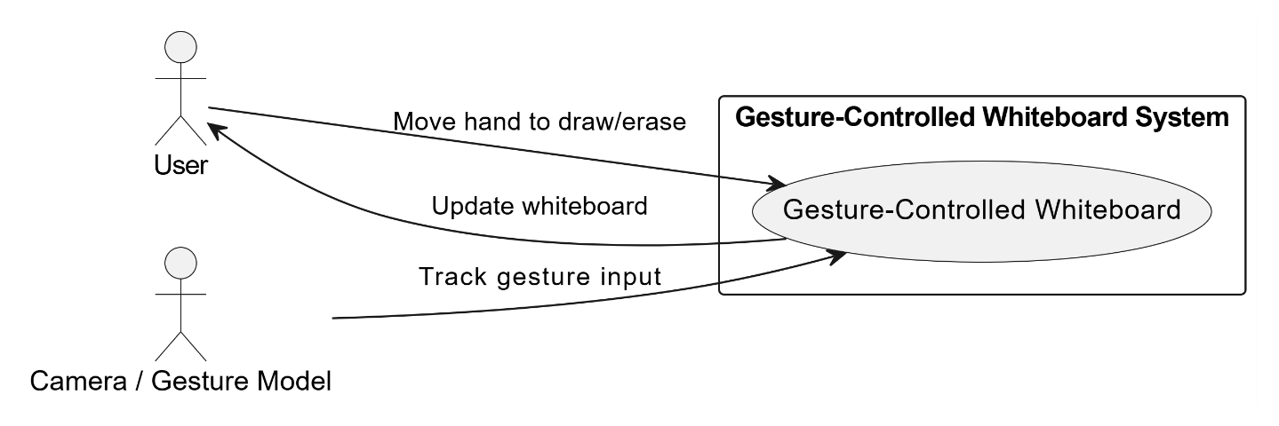
Gesture Whiteboard:
Figure 3 Use Case Diagram – Gesture Whiteboard

Slide 14
UC – Gesture Whiteboard
Field | Details
ID | UC_04
Name | Gesture Whiteboard
Actor | User
Secondary | Camera / Gesture Model
Pre-Condition | Webcam enabled
Post-Condition | Whiteboard updates as per gesture
Basic Flow | 1. Move hand → 2. System draws/erases
Alt. Flow | Gesture not recognized → No action

Slide 15
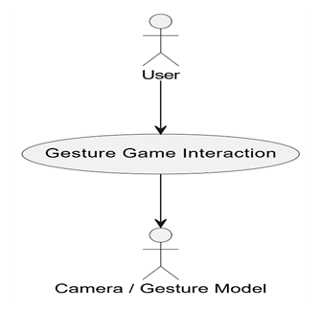
Gesture Game Interaction:
Figure 4 Use Case Diagram – Gesture Game Interaction

Slide 16
UC – Gesture Game Interaction
Field | Details
ID | UC_05
Name | Gesture Game Interaction
Actor | User
Secondary | Camera / Gesture Model
Pre-Condition | Webcam enabled, game in gesture mode
Post-Condition | Game responds to gesture
Basic Flow | 1. Perform gesture → 2. Game reacts accordingly
Alt. Flow | Gesture not recognized → Show prompt

Slide 17
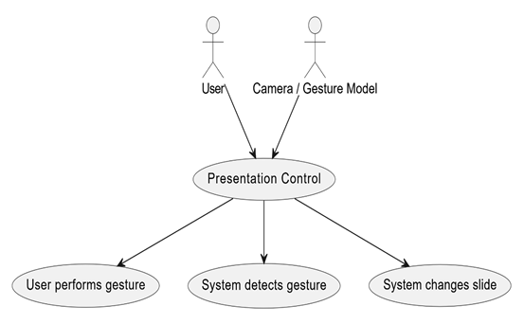
Presentation Control:
Figure 5 Use Case Diagram – Presentation Control

Slide 18
UC – Presentation Control
Field | Details
ID | UC_06
Name | Presentation Control
Actor | User
Secondary | Camera / Gesture Model
Pre-Condition | Webcam enabled, presentation mode active
Post-Condition | Slide changes based on gesture
Basic Flow | 1. Perform gesture → 2. System changes slide
Alt. Flow | Gesture not recognized → Prompt user or stay on slide

Slide 19
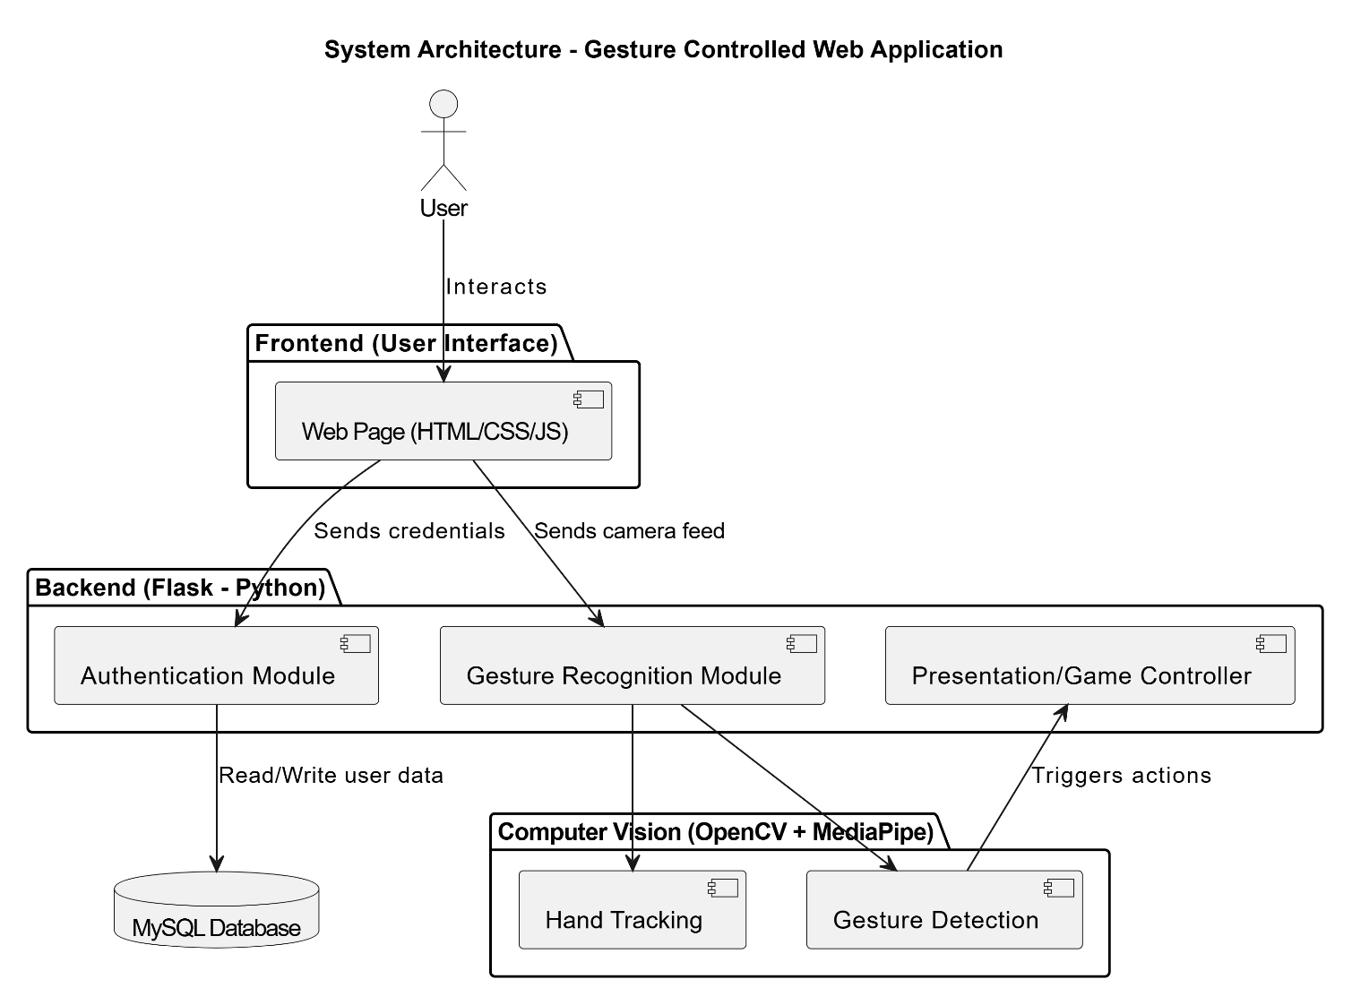
System Architecture
Presentation Layer
User interfaces like Dashboard and Whiteboard.
Application Layer
Flask server handles gesture logic.
Data Layer
MySQL DB for user and session storage.

Slide 20
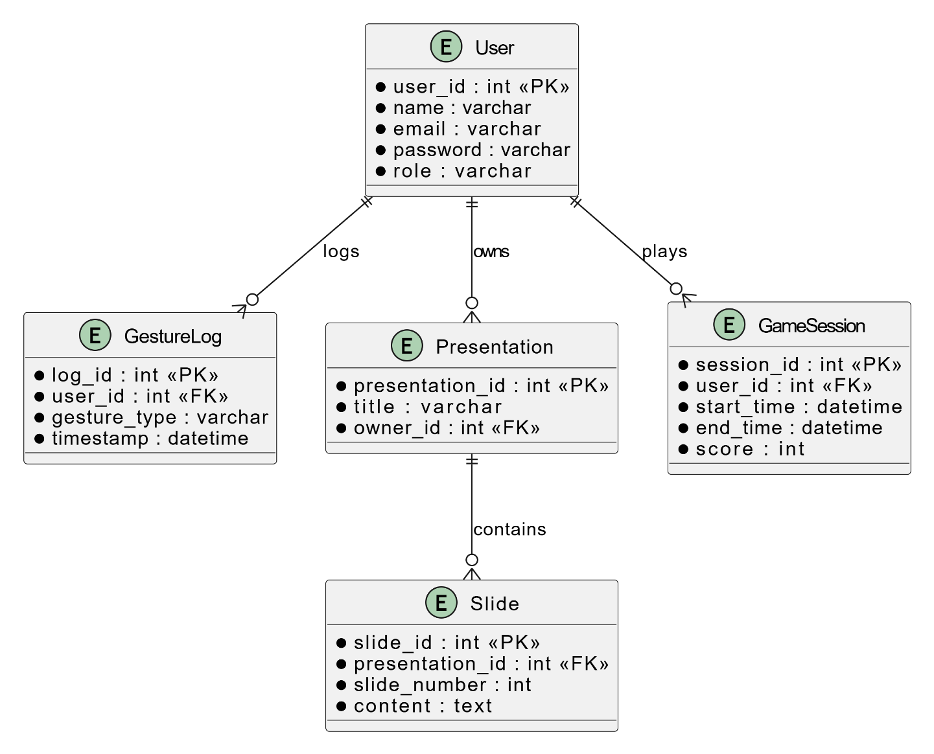
Database Design Highlights

Slide 21




UML Diagrams Overview
Activity Diagram
Sequence Diagram
Collaboration Diagrams
State Diagram
Component Diagram
Deployment Diagram

Slide 22
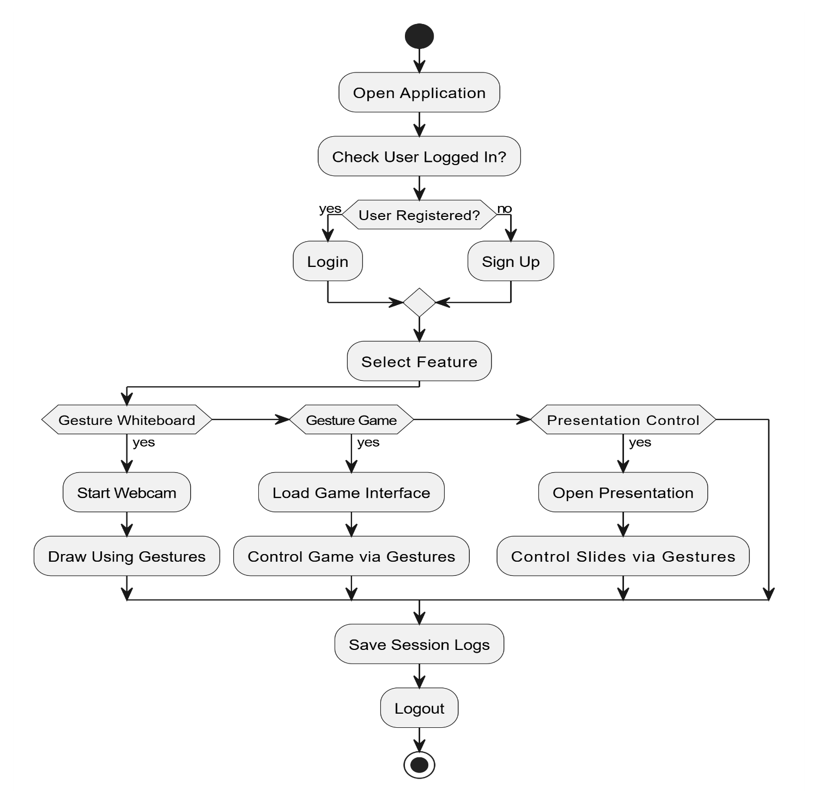
Aggregated Activity Diagram – Motion Mind

Slide 23
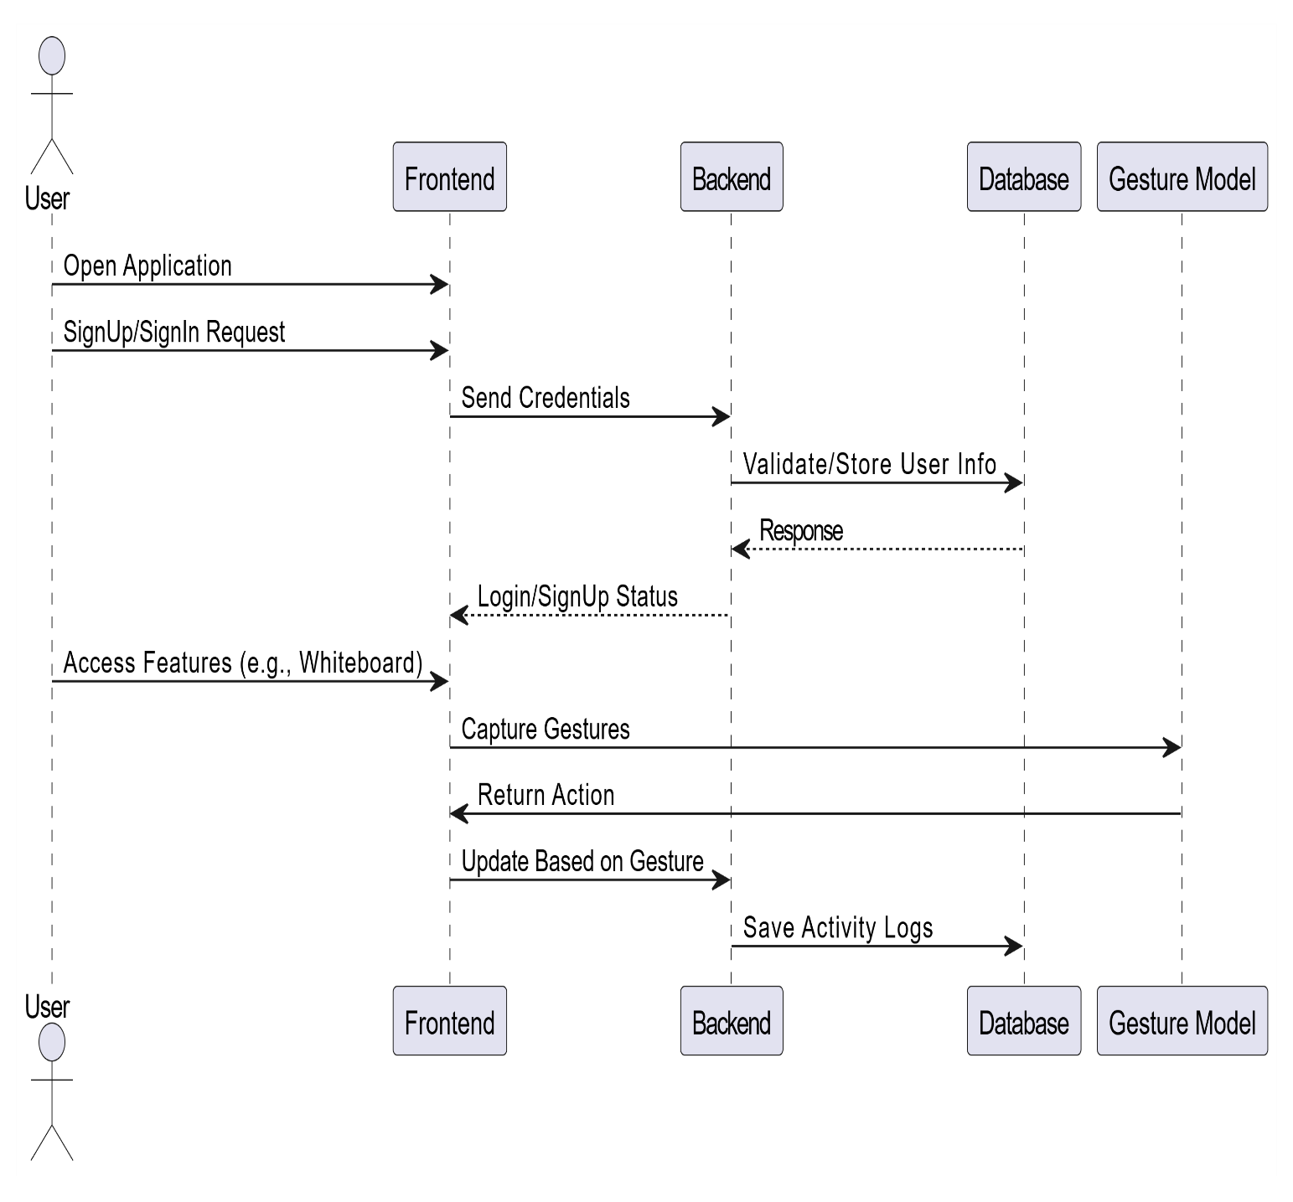
Aggregated Sequence Diagram – Motion Mind

Slide 24
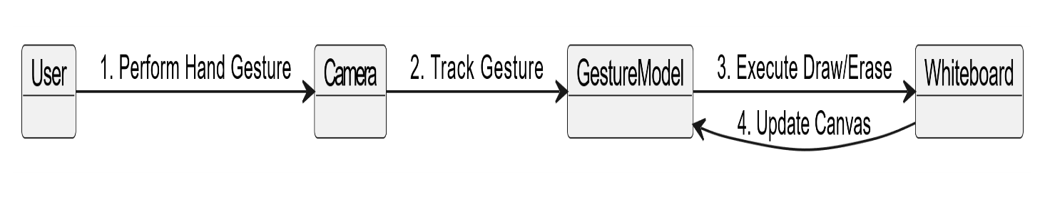
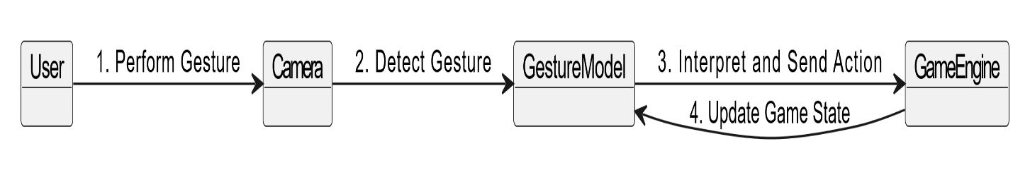
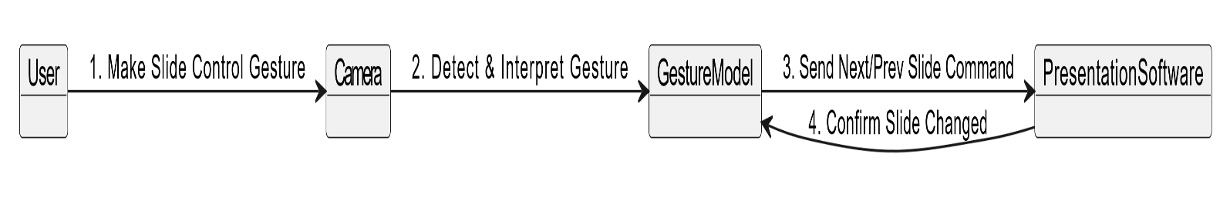
Collaboration Diagram – Gesture Whiteboard
Collaboration Diagram – Gesture Game Interaction
Collaboration Diagram – Presentation Control

Slide 25
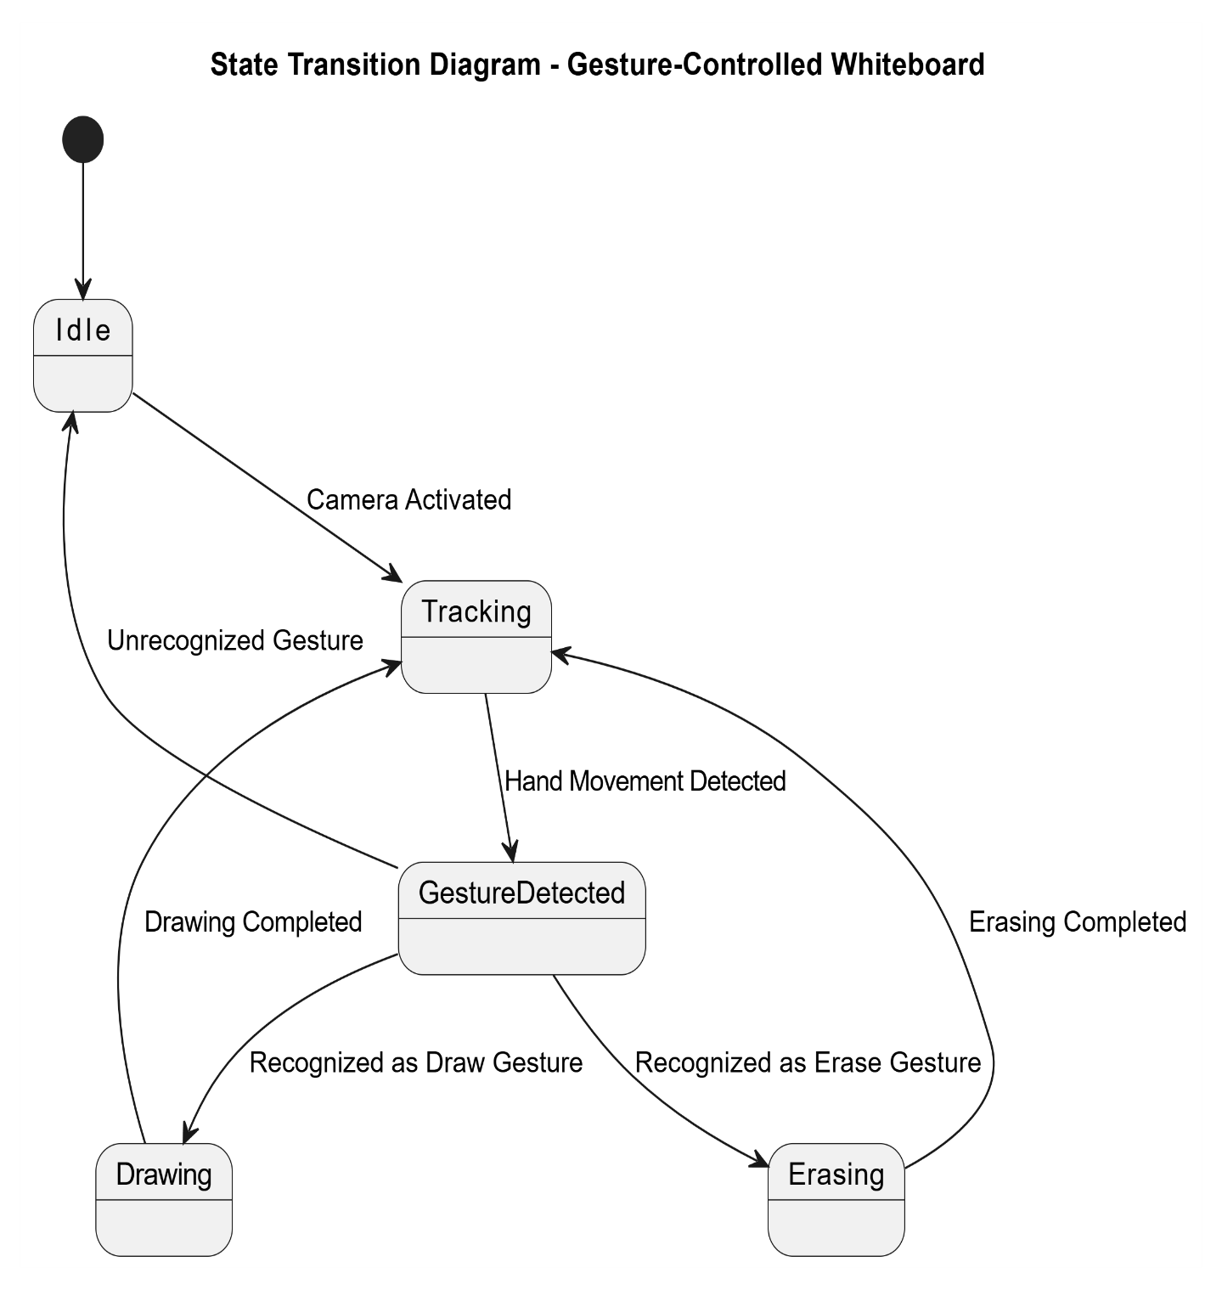

Slide 26
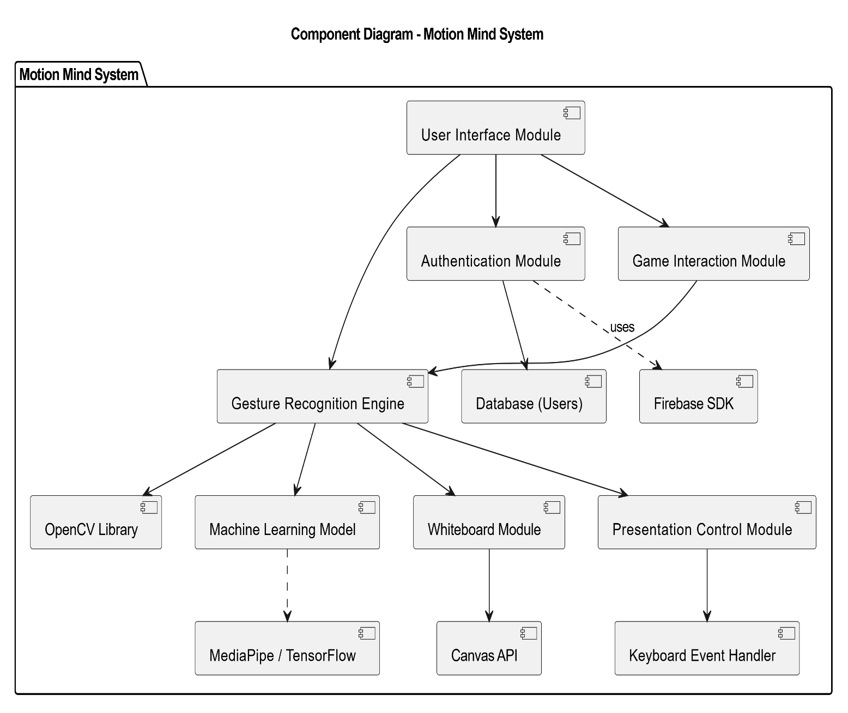

Slide 27
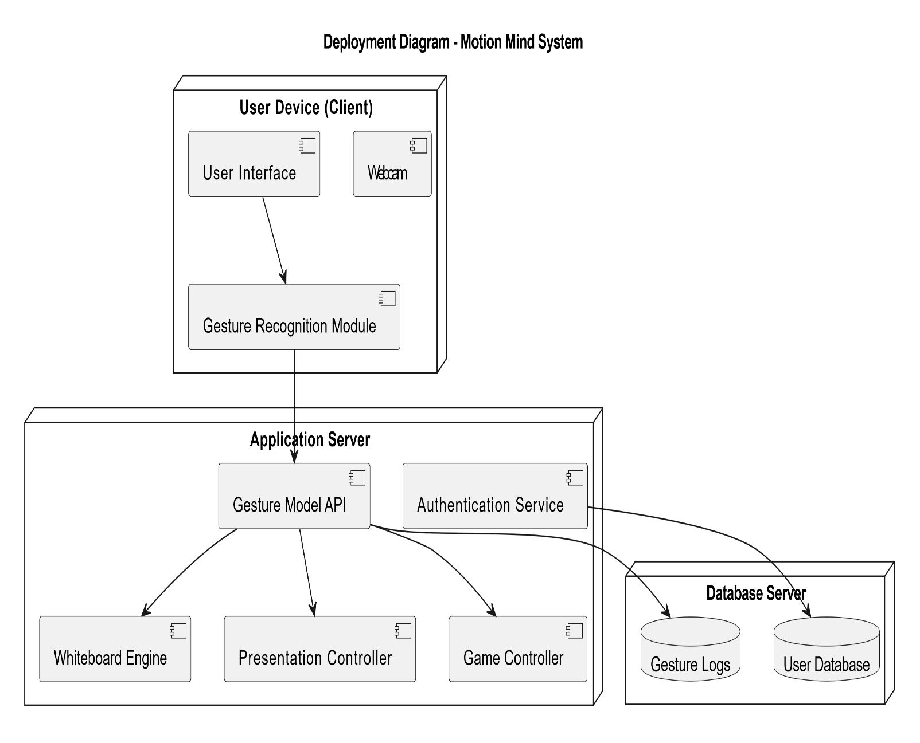

Slide 28
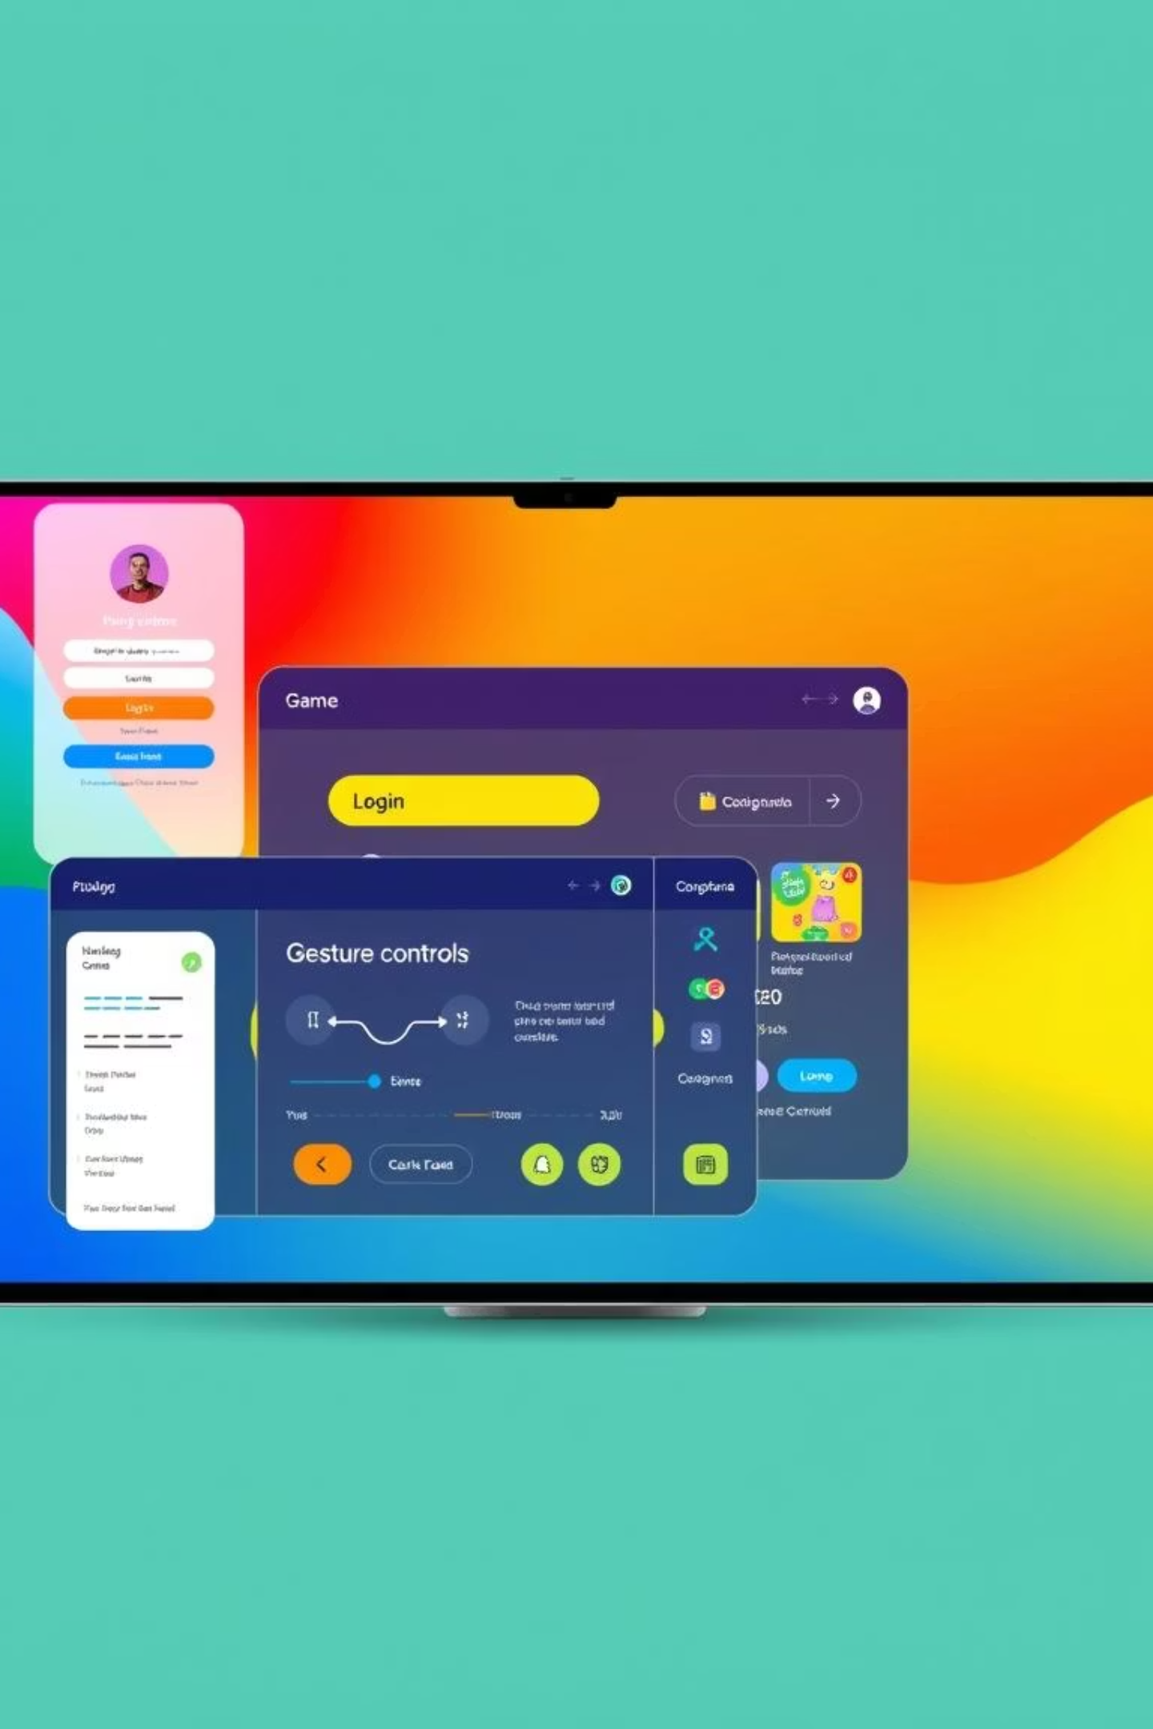
Design & Implementation Progress
UI Design Complete
Login, Dashboard, Whiteboard interfaces fully designed.
Gesture-Enabled Whiteboard
Working whiteboard with integrated gesture support.
Database Schema
Database schema successfully implemented.
Functional Workflow
Account and presentation control workflows are functional.

Slide 29
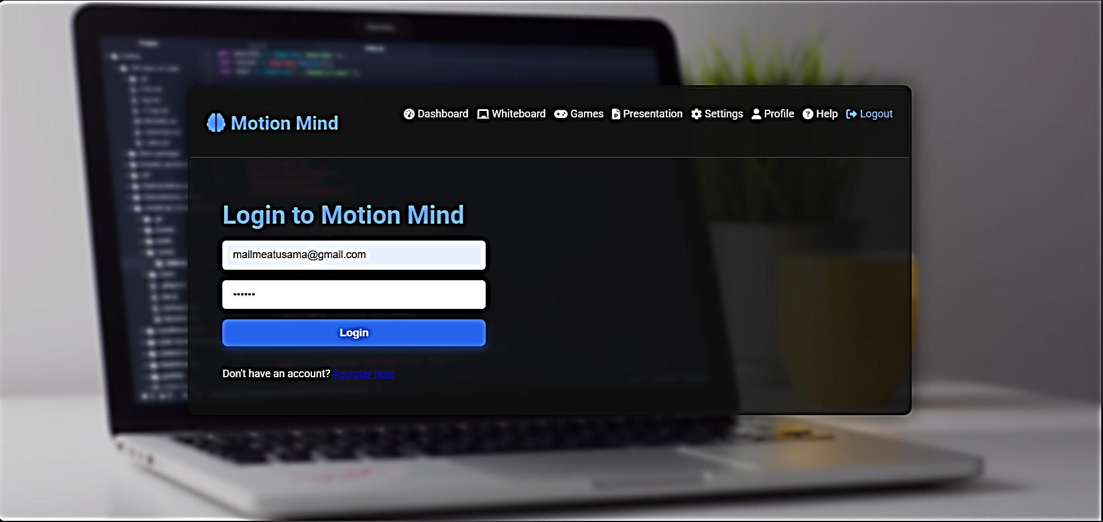

Slide 30
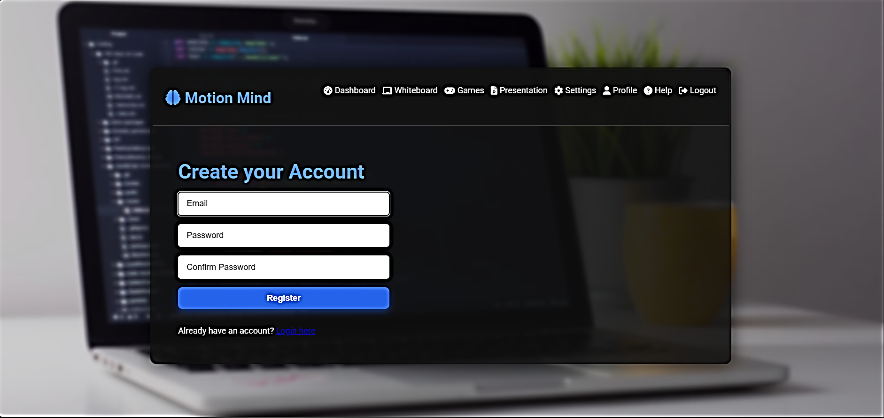

Slide 31
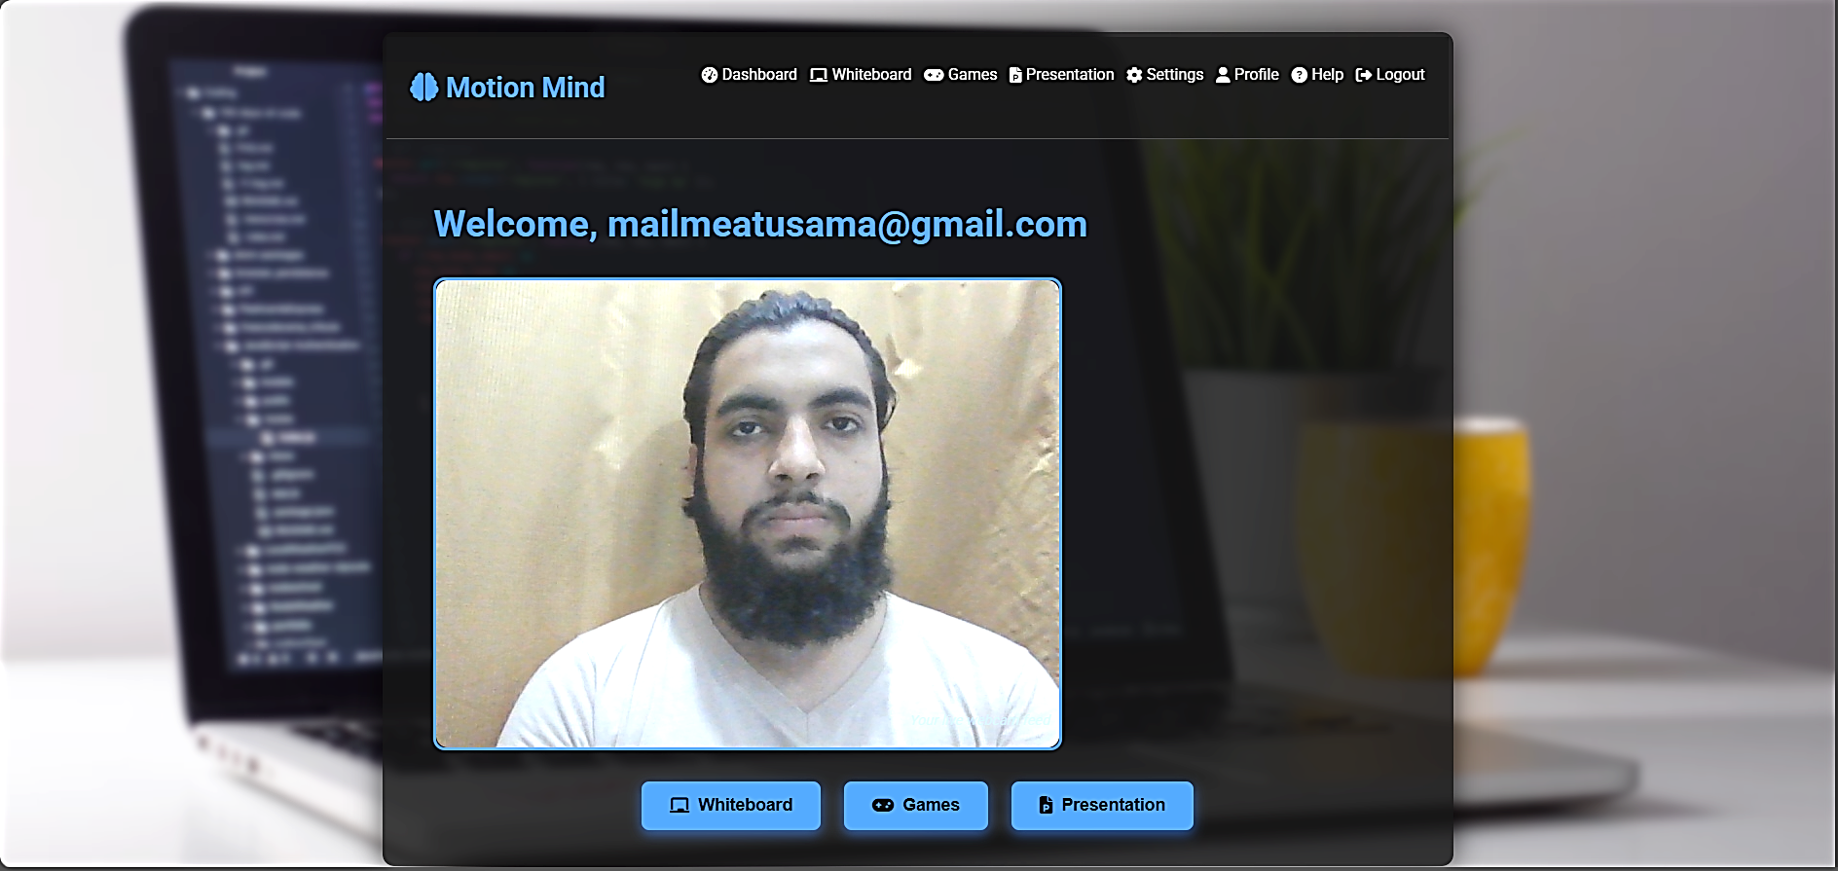

Slide 32
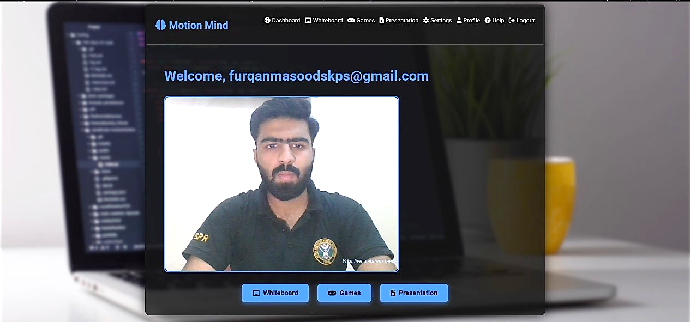

Slide 33
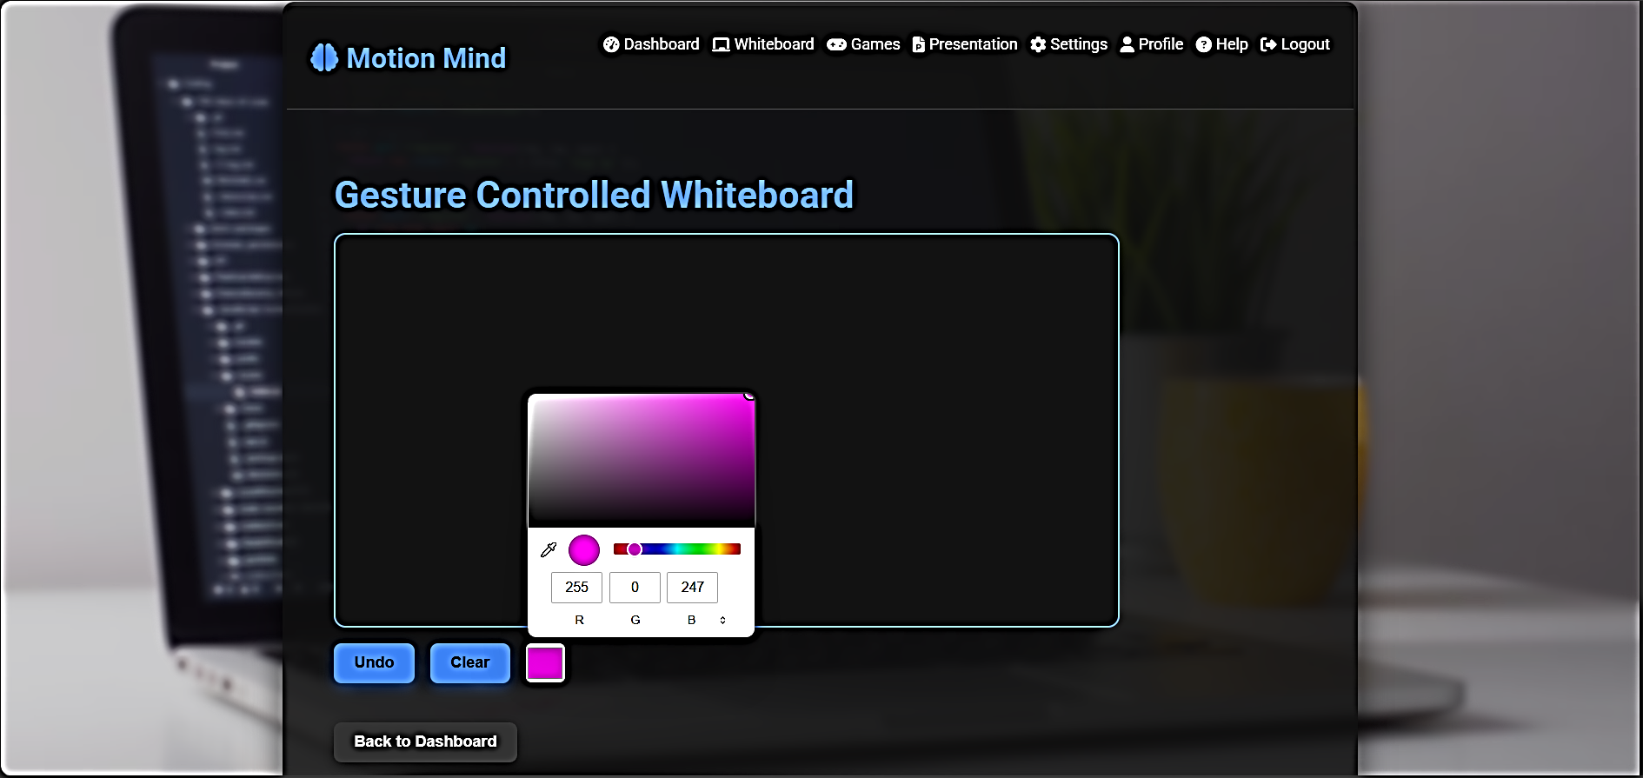

Slide 34
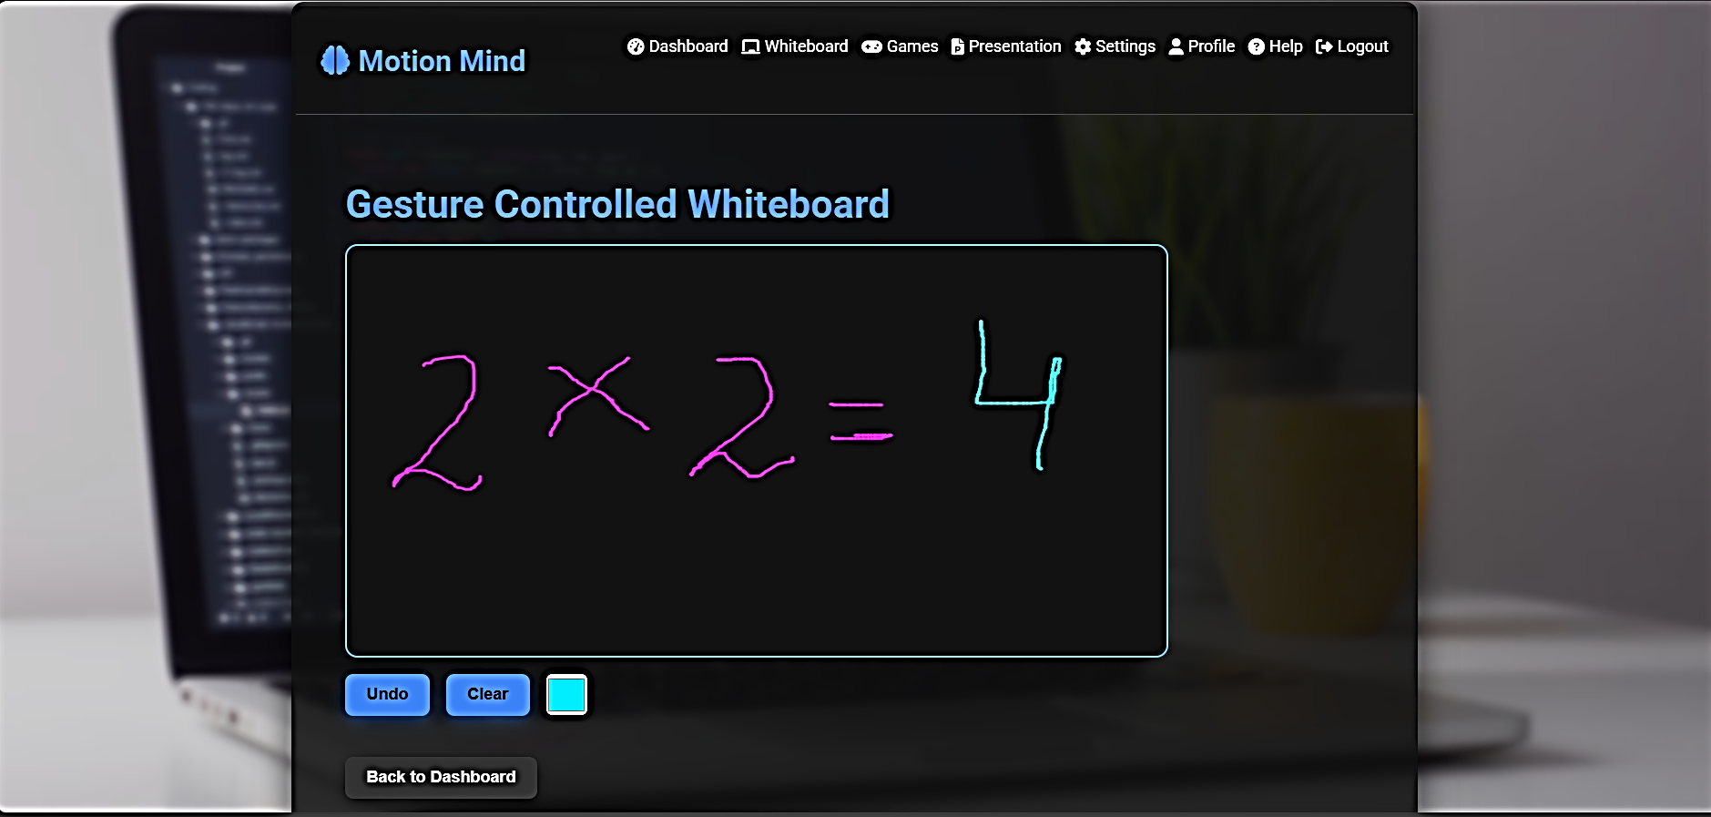

Slide 35
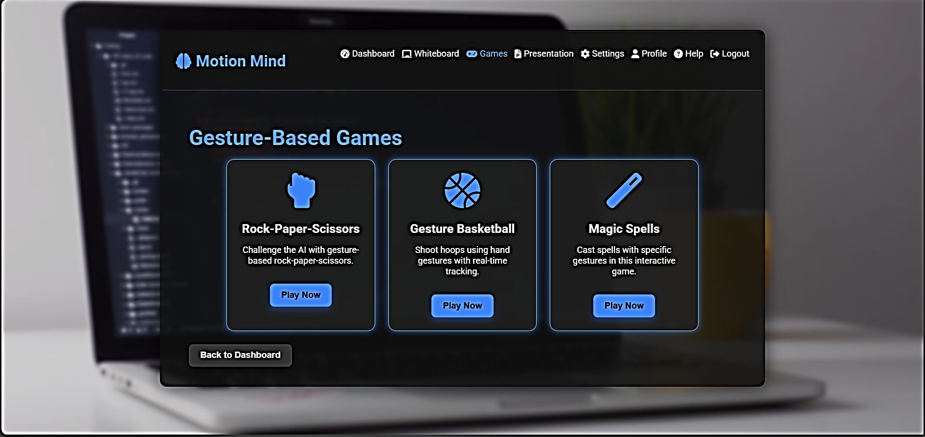

Slide 36
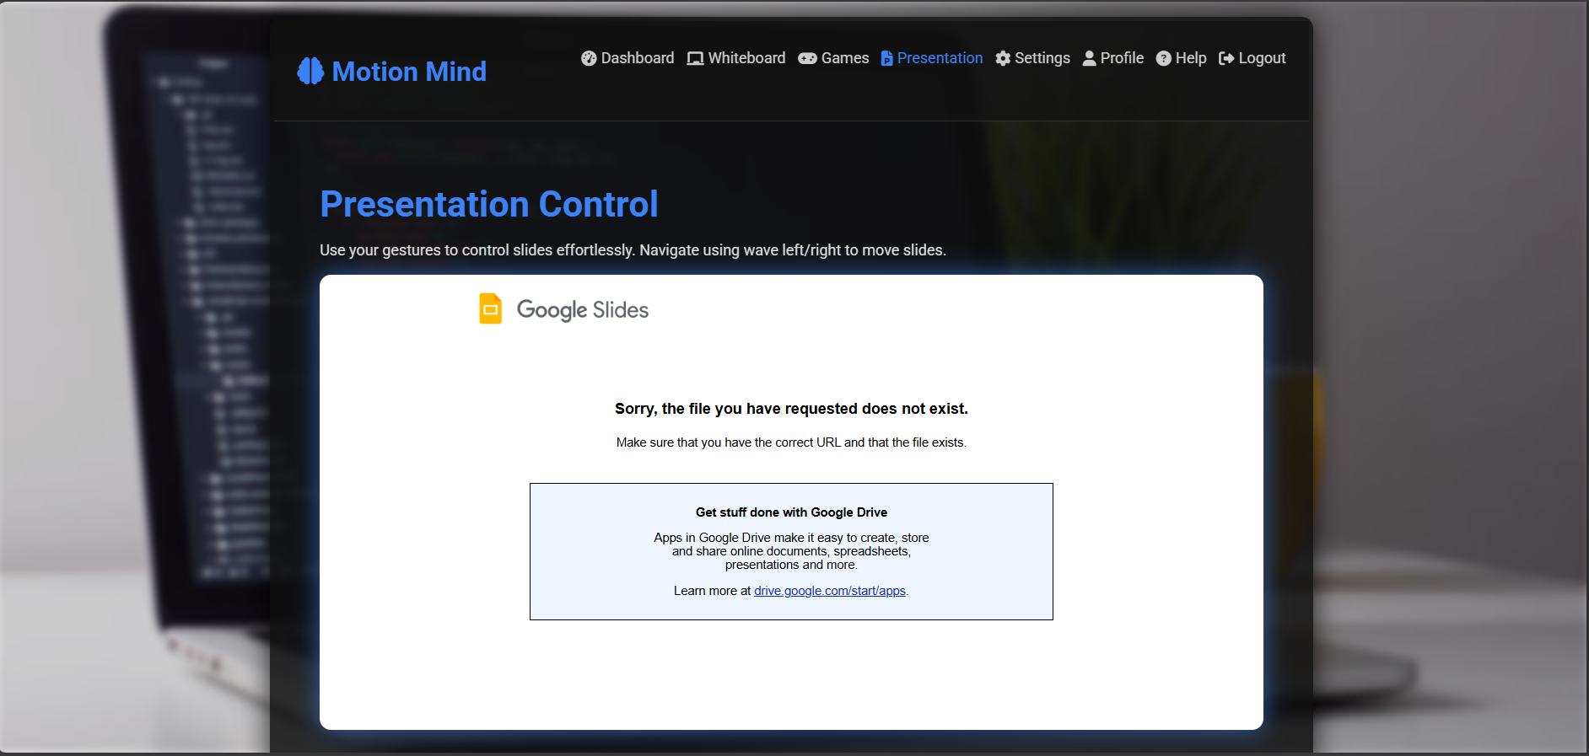

Slide 37
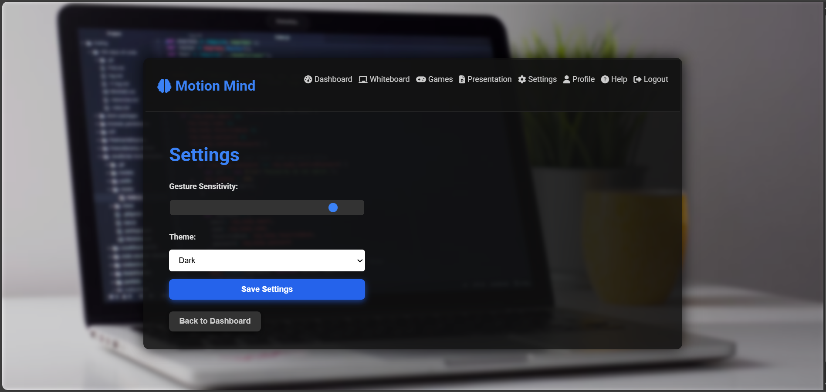
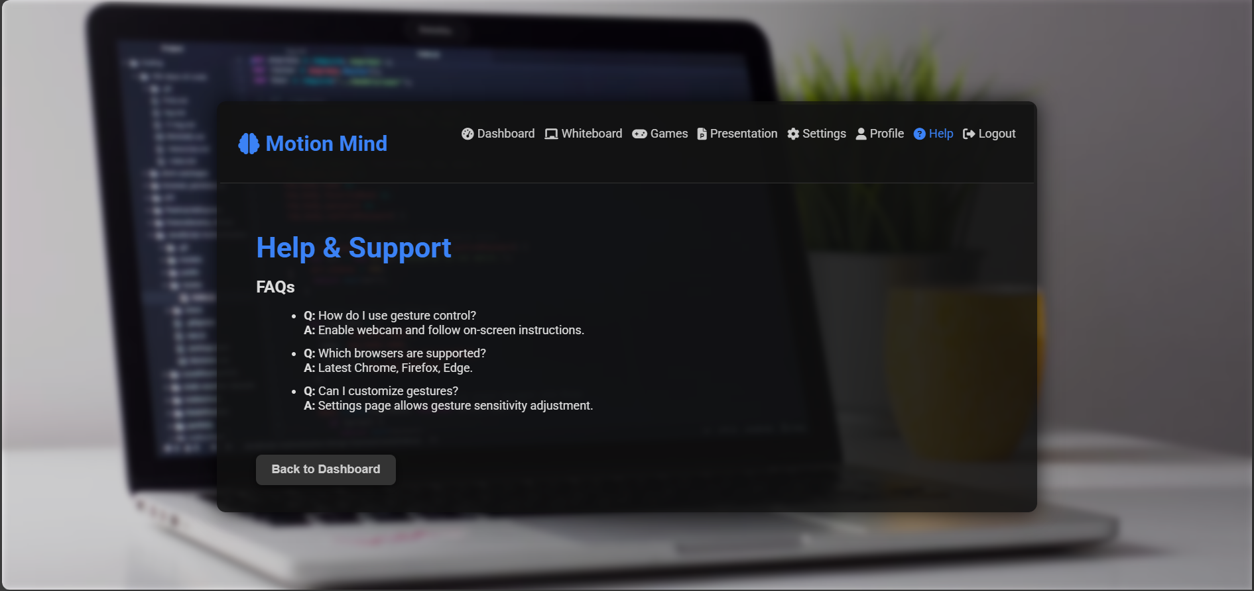
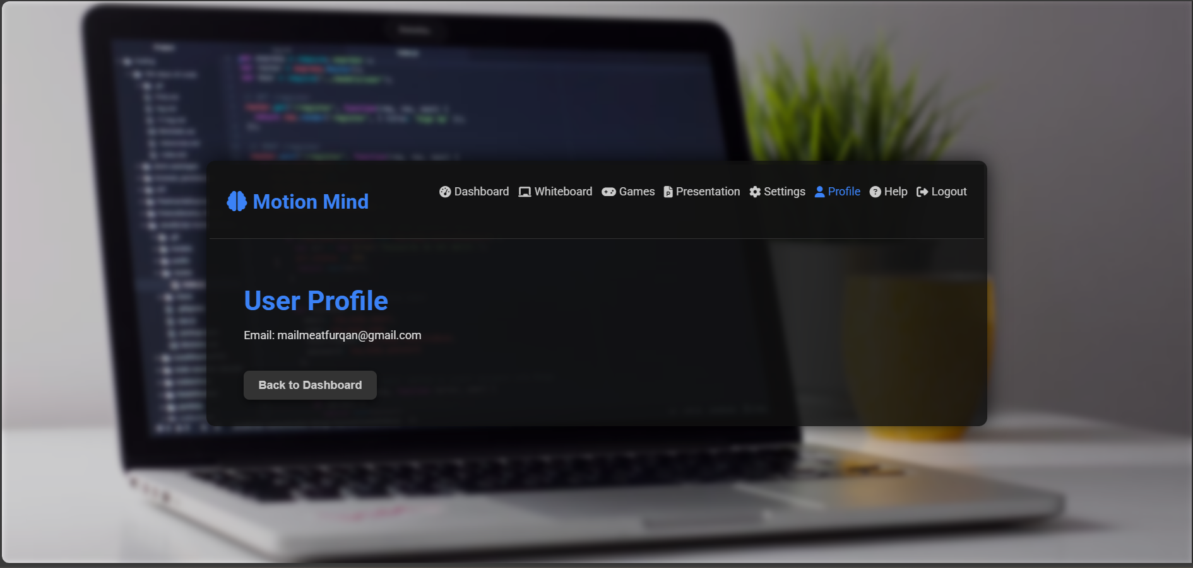
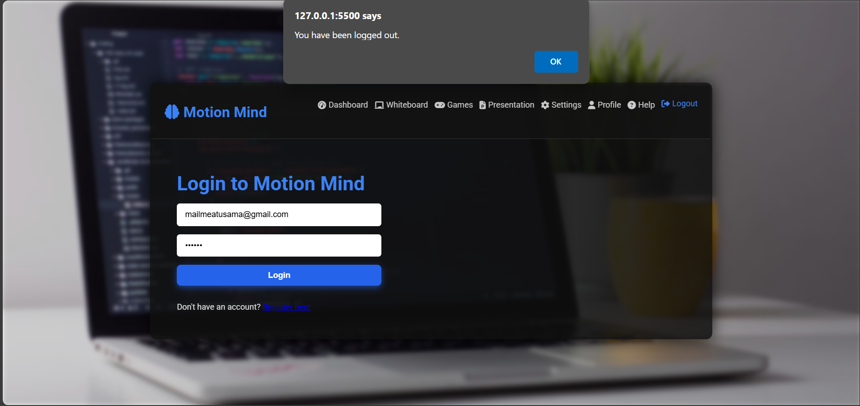

Slide 38
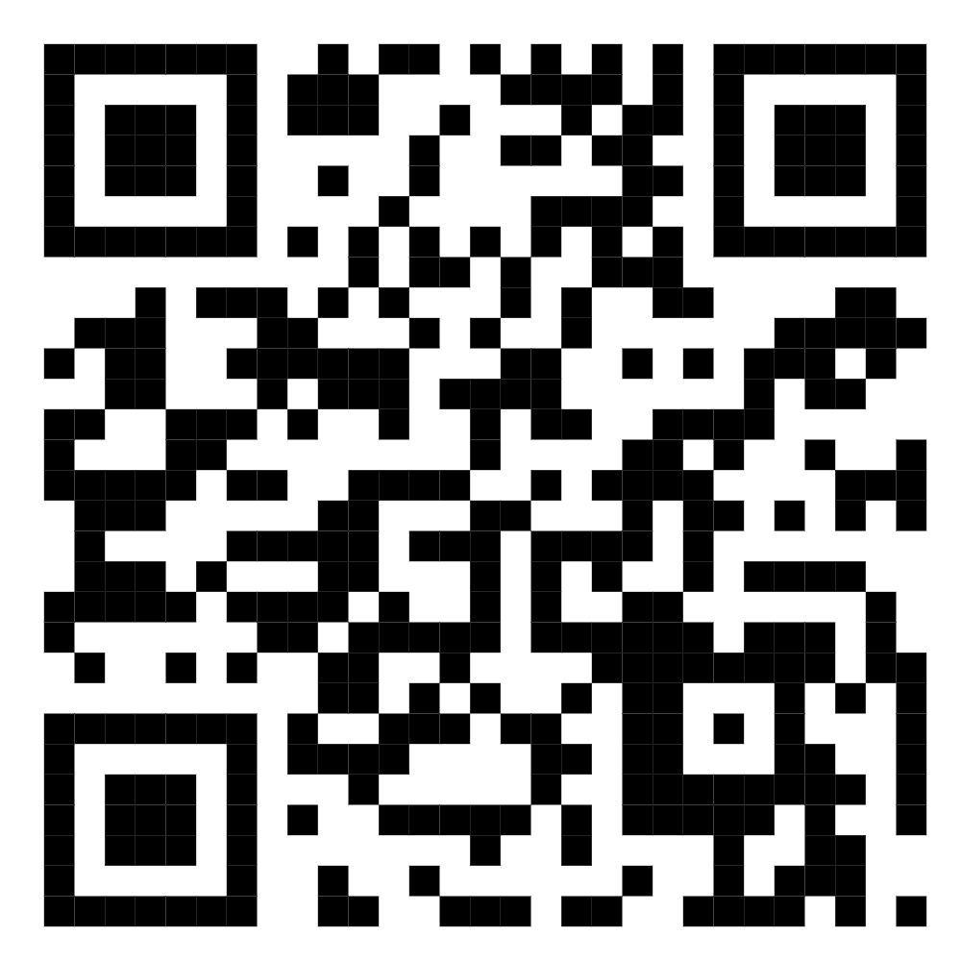
Visit Our Live Website Frontend Prototype
https://motionmindweb.netlify.app/

Slide 39

References
Kaehler, A., & Bradski, G. (2016). Learning OpenCV 3
Minichino, J., & Howse, J. (2020). Learning OpenCV 4 with Python
Munir, S., et al. (2022). Hand Gesture Recognition: A Review
U.S. Department of Education (2023). AI and Future of Teaching

Slide 40
Project Contribution
ID | Task | Assigned | Duration | February | May | June
1 | Chapter1 | Furqan, Usama | 1 month | ██████
2 | Chapter2 | Usama | 1 month | ██████
3 | Chapter3 | Furqan | 1 month | ██████
4 | Chapter4 | Furqan, Usama | 1 month | ██████
5 | Chapter5 | Furqan, Usama | 1 month |  | ██████
6 | Presentation | Furqan, Usama | 3 Days |  |  | ██████

Slide 41
 | Sr. # | Task | 2025-2026
 |  |  | Jan 2025 | Feb-Mar 2025 | April 2025 | May 2025 | Jun-Aug 2025 | Sep 2025 | Oct 2025 | Nov 2025 | Dec 2025 | Jan 2026
 | 1 | Finalization of topic and basic understanding of the project | ------
 | 2 | Learn ML, Deep Learning and Digital Image Processing |  | ------
 | 3 | Implement a base code for the project and explore datasets |  |  | ------
 | 4 | Complete Documentation |  |  |  | ------
 | 5 | Try Multiple approaches to enhance it and Train Model |  |  |  |  | ------
 | 6 | Design Front end of the App |  |  |  |  |  | ------
 | 7 | Integrate the model |  |  |  |  |  |  | ------
 | 8 | Test Application & interface |  |  |  |  |  |  |  | ------
 | 9 | Completing Documentation |  |  |  |  |  |  |  |  | ------
 | 10 | Revisions and final Submission & Delivery |  |  |  |  |  |  |  |  |  | ------

Slide 42


